Slide 1
RESULTS SHOWCASE
Acute Netrin-1 RNA-seq
A 5-min transcriptional pulse that reverses by 15 min
QC
DEG
LRT
GSEA
interpretable
acute anchors
time genes
reversal
32 DEGs | 19 LRT genes | 313 GO BP terms | r = -0.991 pathway mirror
Re-designed from handmade.pptx
01
Notes:
Open with the results arc. This is the redesigned version based on the handmade content, with a more varied layout system.

Slide 2
EXPERIMENTAL CONTRASTS
The result sequence follows onset, time-dependence, then reversal
The handmade analysis is reorganized around the biological question each contrast answers.
Vehicle
>
5 min
>
15 min
>
5v0
>
15v5
>
15v0
PBS control
acute Netrin-1
later Netrin-1
onset
reversal
endpoint
Statistical backbone
DESeq2 model: ~ replicate + timepoint. Wald contrasts summarize pairwise effects; LRT tests whether a gene changes anywhere across the time course; GSEA ranks genes by Wald statistic.
Source: handmade methods slides
02
Notes:
Use this as a clean map before showing results.

Slide 3
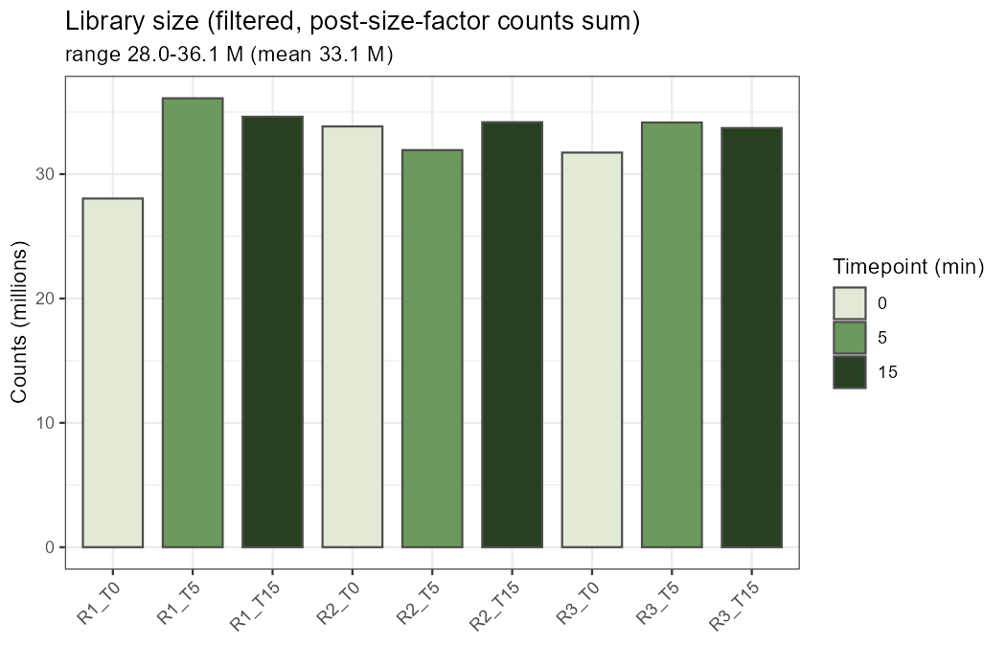
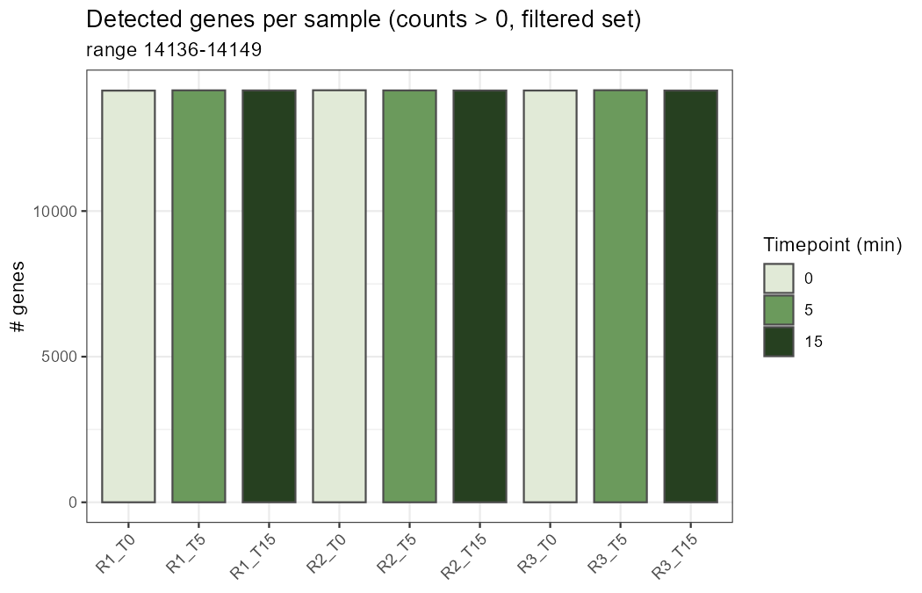
QC AND FILTERING
Sample depth is comparable after filtering to 14,161 genes
This condenses the handmade filtering and sequencing-depth slides into one result page.
32,623 quantified genes -> 14,161 genes for DE analysis
Source: results/01_QC
03
Notes:
Filtering and basic QC are shown together so the result flow does not stall early.

Slide 4
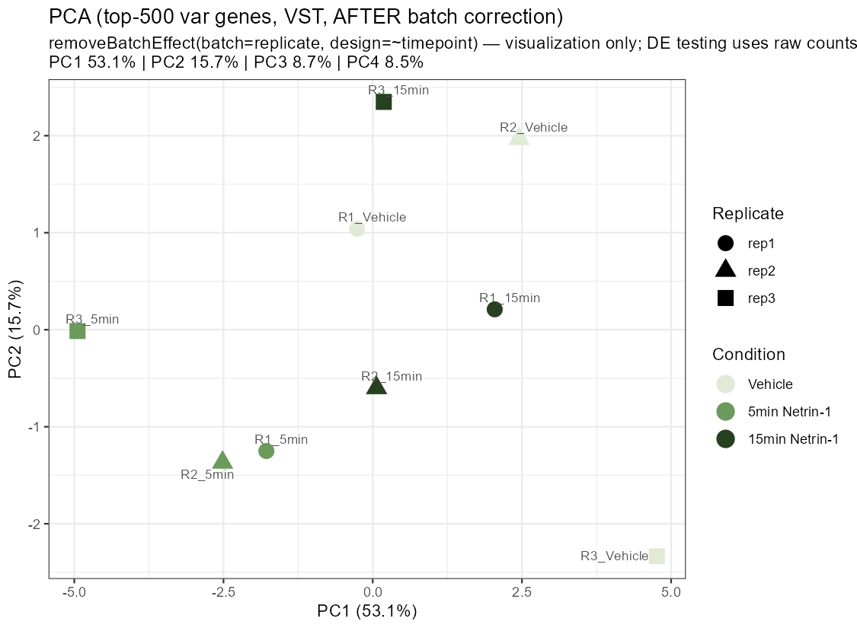
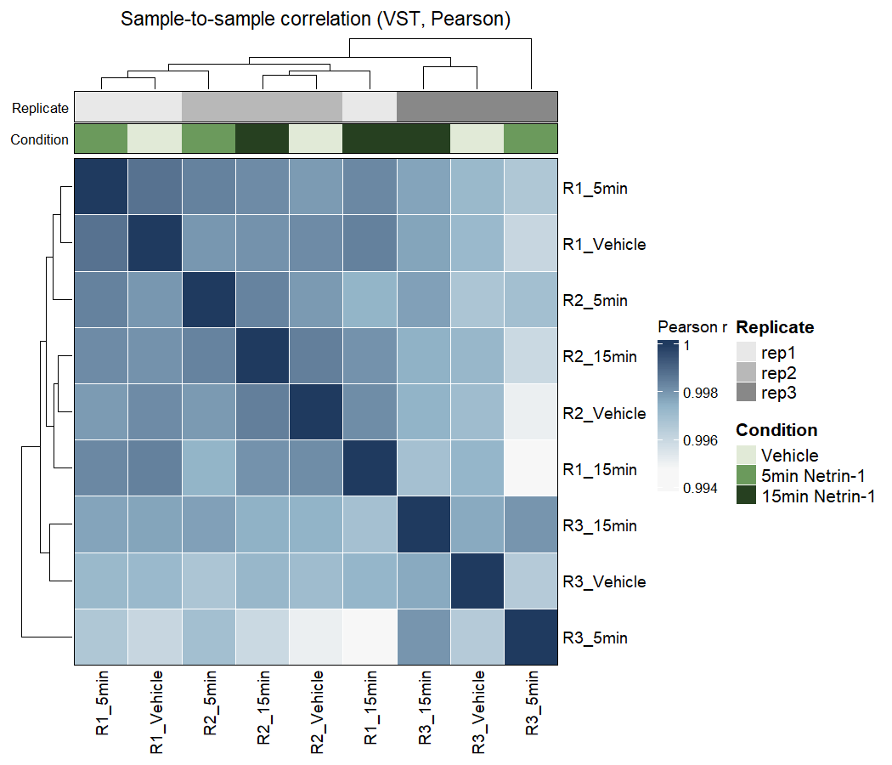
SAMPLE STRUCTURE
Replicate effects are visible, but corrected PCA reveals timepoint structure
This supports the model choice and the biological interpretation.
Replicate was included in the DESeq2 model; batch correction was used only for PCA visualization.
Source: results/01_QC
04
Notes:
State this carefully; it is one of the most important statistical safeguards.

Slide 5
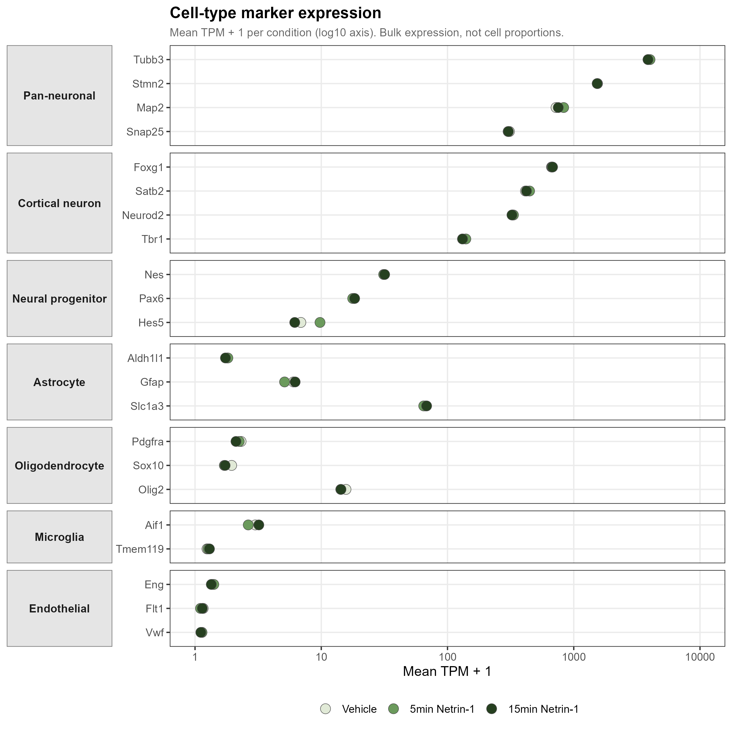
CULTURE COMPOSITION
Marker expression supports neuron-dominant, composition-stable cultures
The transcriptomic response is not explained by a visible cell-composition shift.
Key readout
- Neuronal markers dominate.
- Glial/endothelial markers remain low.
- Conditions are nearly overlapping.
Source: results/02_composition
05
Notes:
This follows the handmade marker slide but with a cleaner figure-first design.

Slide 6
DEG OVERVIEW
The largest single-gene response occurs at 5 min
The DEG layer gives acute anchors, while LRT and GSEA provide the temporal and pathway layers.
32
Contrast
Question
Relaxed
Strict
Direction
5v0 relaxed DEGs
5v0
onset
32
5
14 up / 18 down
15v5
reversal
6
2
6 up / 0 down
5
15v0
endpoint
1
1
0 up / 1 down
5v0 strict DEGs
LRT
time effect
19
n/a
time-varying genes
Source: DEG CSV files and handmade slide 5
06
Notes:
This is still your handmade table, but with hierarchy and metrics separated.

Slide 7
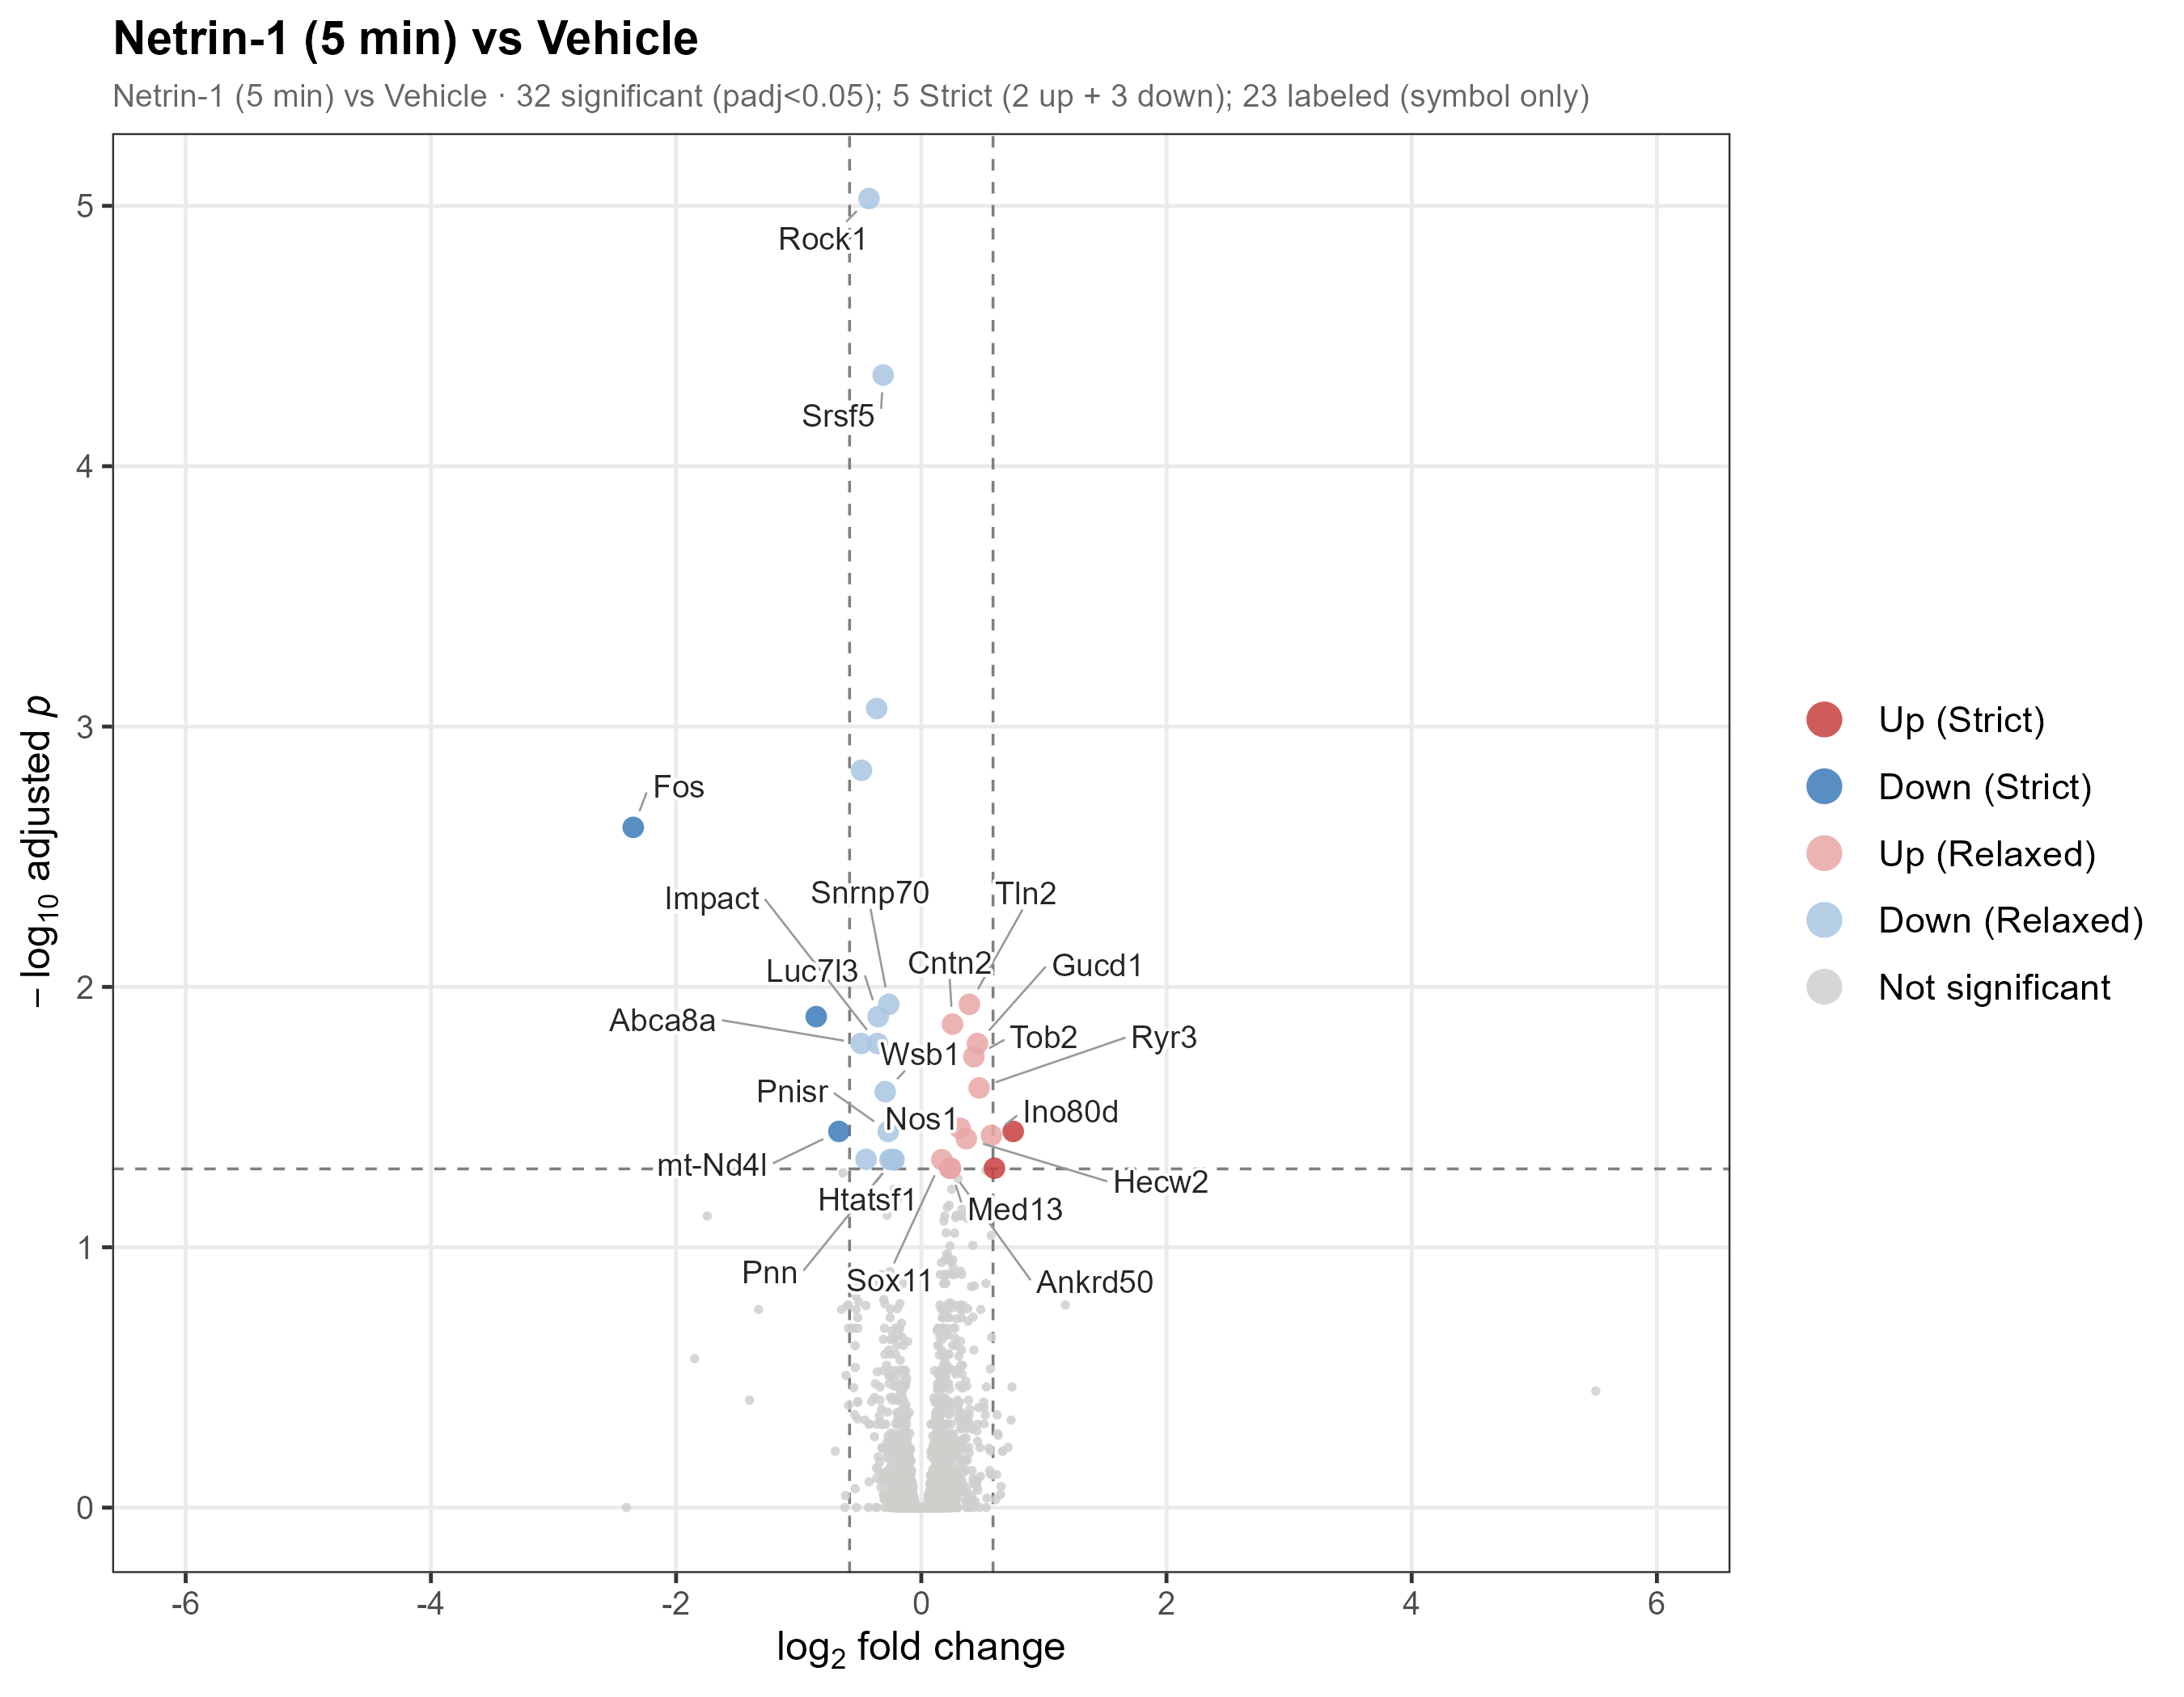
5-MIN DIFFERENTIAL EXPRESSION
A small DEG set captures interpretable acute response genes
Gene anchors
- Fos: IEG suppression
- Rock1: cytoskeleton
- Srsf5/Snrnp70: splicing
- Cntn2: axon guidance
- Nos1/Ryr3: NO-calcium
Source: results/03_DEG/04_volcano_5v0_v6.png
07
Notes:
The volcano plot is treated as a hero figure rather than one more small panel.

Slide 8
DEG MODULES
Representative 5-min DEGs split into suppressed and activated modules
This makes the biological direction clearer than a plain gene list.
Suppressed at 5 min
Activated at 5 min
Fos
-2.35
IEG
Cntn2
+0.25
axon guidance
Rock1
-0.43
cytoskeleton
Nos1
+0.32
NO-calcium
Srsf5
-0.31
splicing
Ryr3
+0.47
calcium release
Snrnp70
-0.27
splicing
Tln2
+0.39
adhesion
Source: DEG_5v0_ALL.csv and handmade slide 7
08
Notes:
This replaces the table-only feel with a directional module layout.

Slide 9
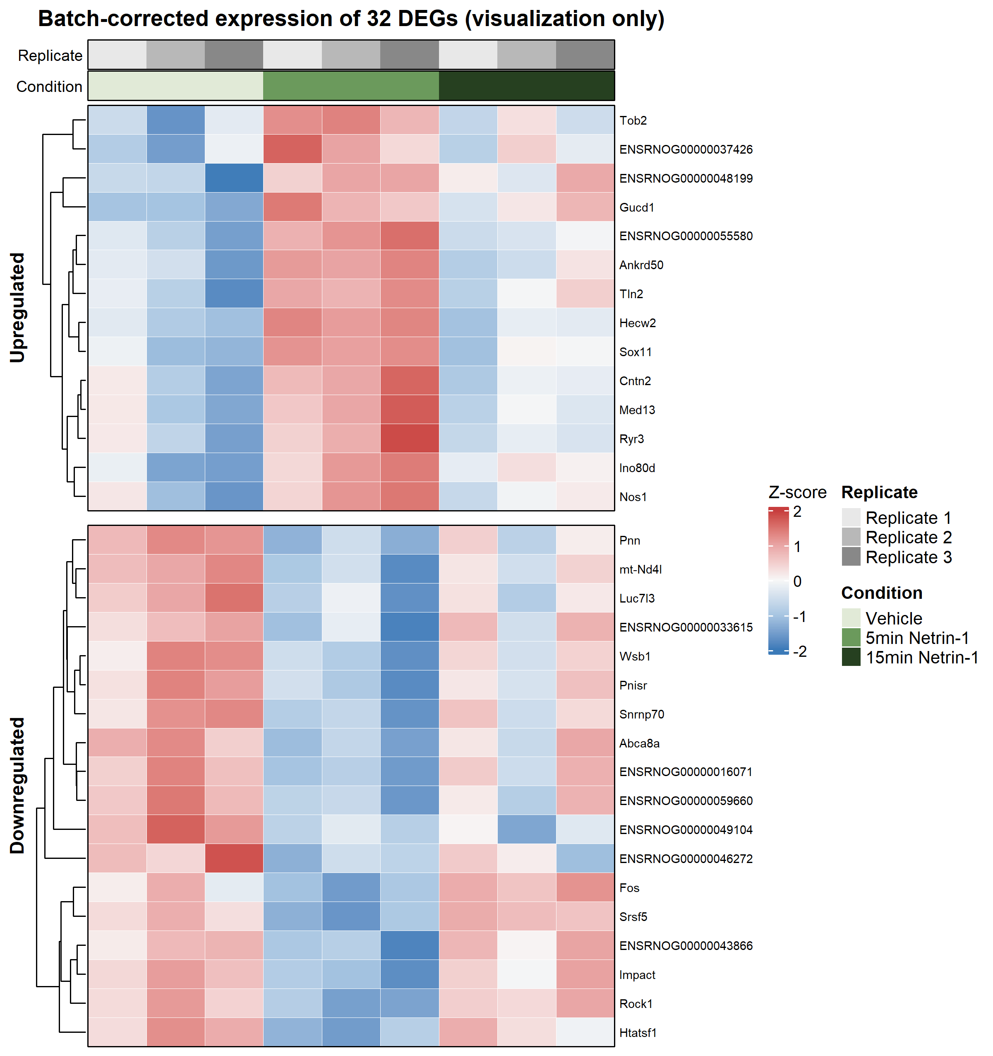
DEG HEATMAP
The 5-min DEG set forms a coherent sample-level expression pattern
The heatmap supports a coordinated acute response rather than isolated outliers.
Interpretation
The response is distributed across the selected DEG set and visible at sample level.
Source: results/03_DEG/06_DEG_heatmap_5v0_v4.png
09
Notes:
Another result visual, but with a different stage-like layout.

Slide 10
LRT ANALYSIS
LRT tests time-dependence rather than a single pairwise contrast
This turns the handmade LRT title slide into a scientifically explicit result slide.
Full model
Reduced model
Trajectory y-axis
~ replicate + timepoint
~ replicate
Z-score of VST-normalized expression
19
time-varying genes
Source: DESeq2 LRT
10
Notes:
Explain why log2FC is not the best y-axis for LRT trajectories.

Slide 11
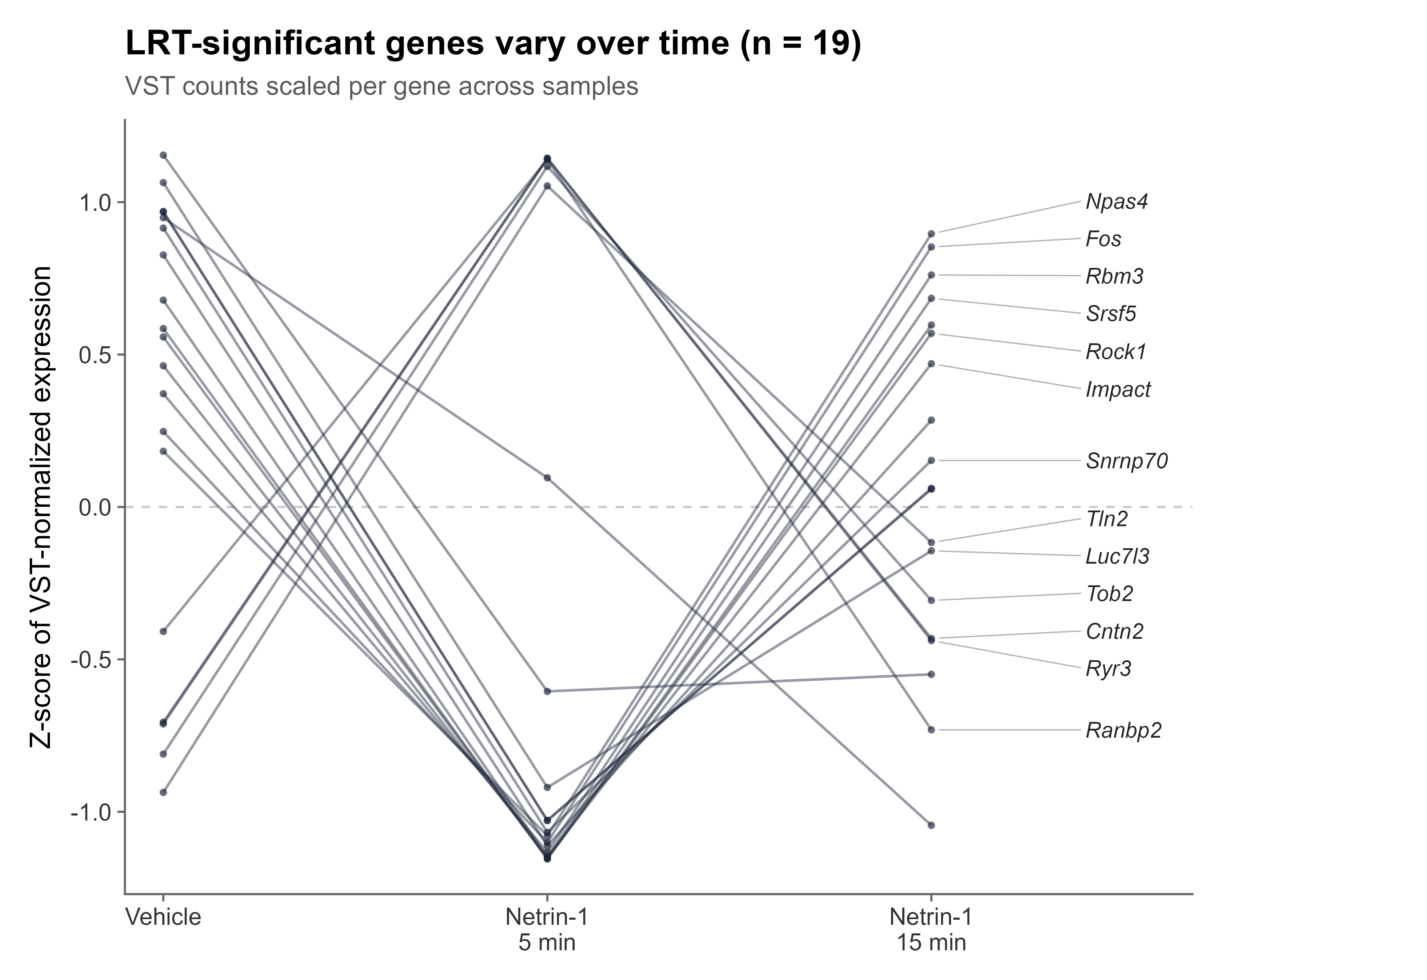
LRT TRAJECTORIES
Nineteen time-varying genes show coordinated 5-min deviation and recovery/rebound
Values are scaled per gene to emphasize temporal shape.
Readout
- Rows are genes.
- Pulse-like profiles dominate.
- Fos/Npas4 support IEG suppression.
Source: results/objects/LRT_19_trajectory_VSTzscore_v1.png
11
Notes:
This is the replacement for the sparse handmade LRT slide.

Slide 12
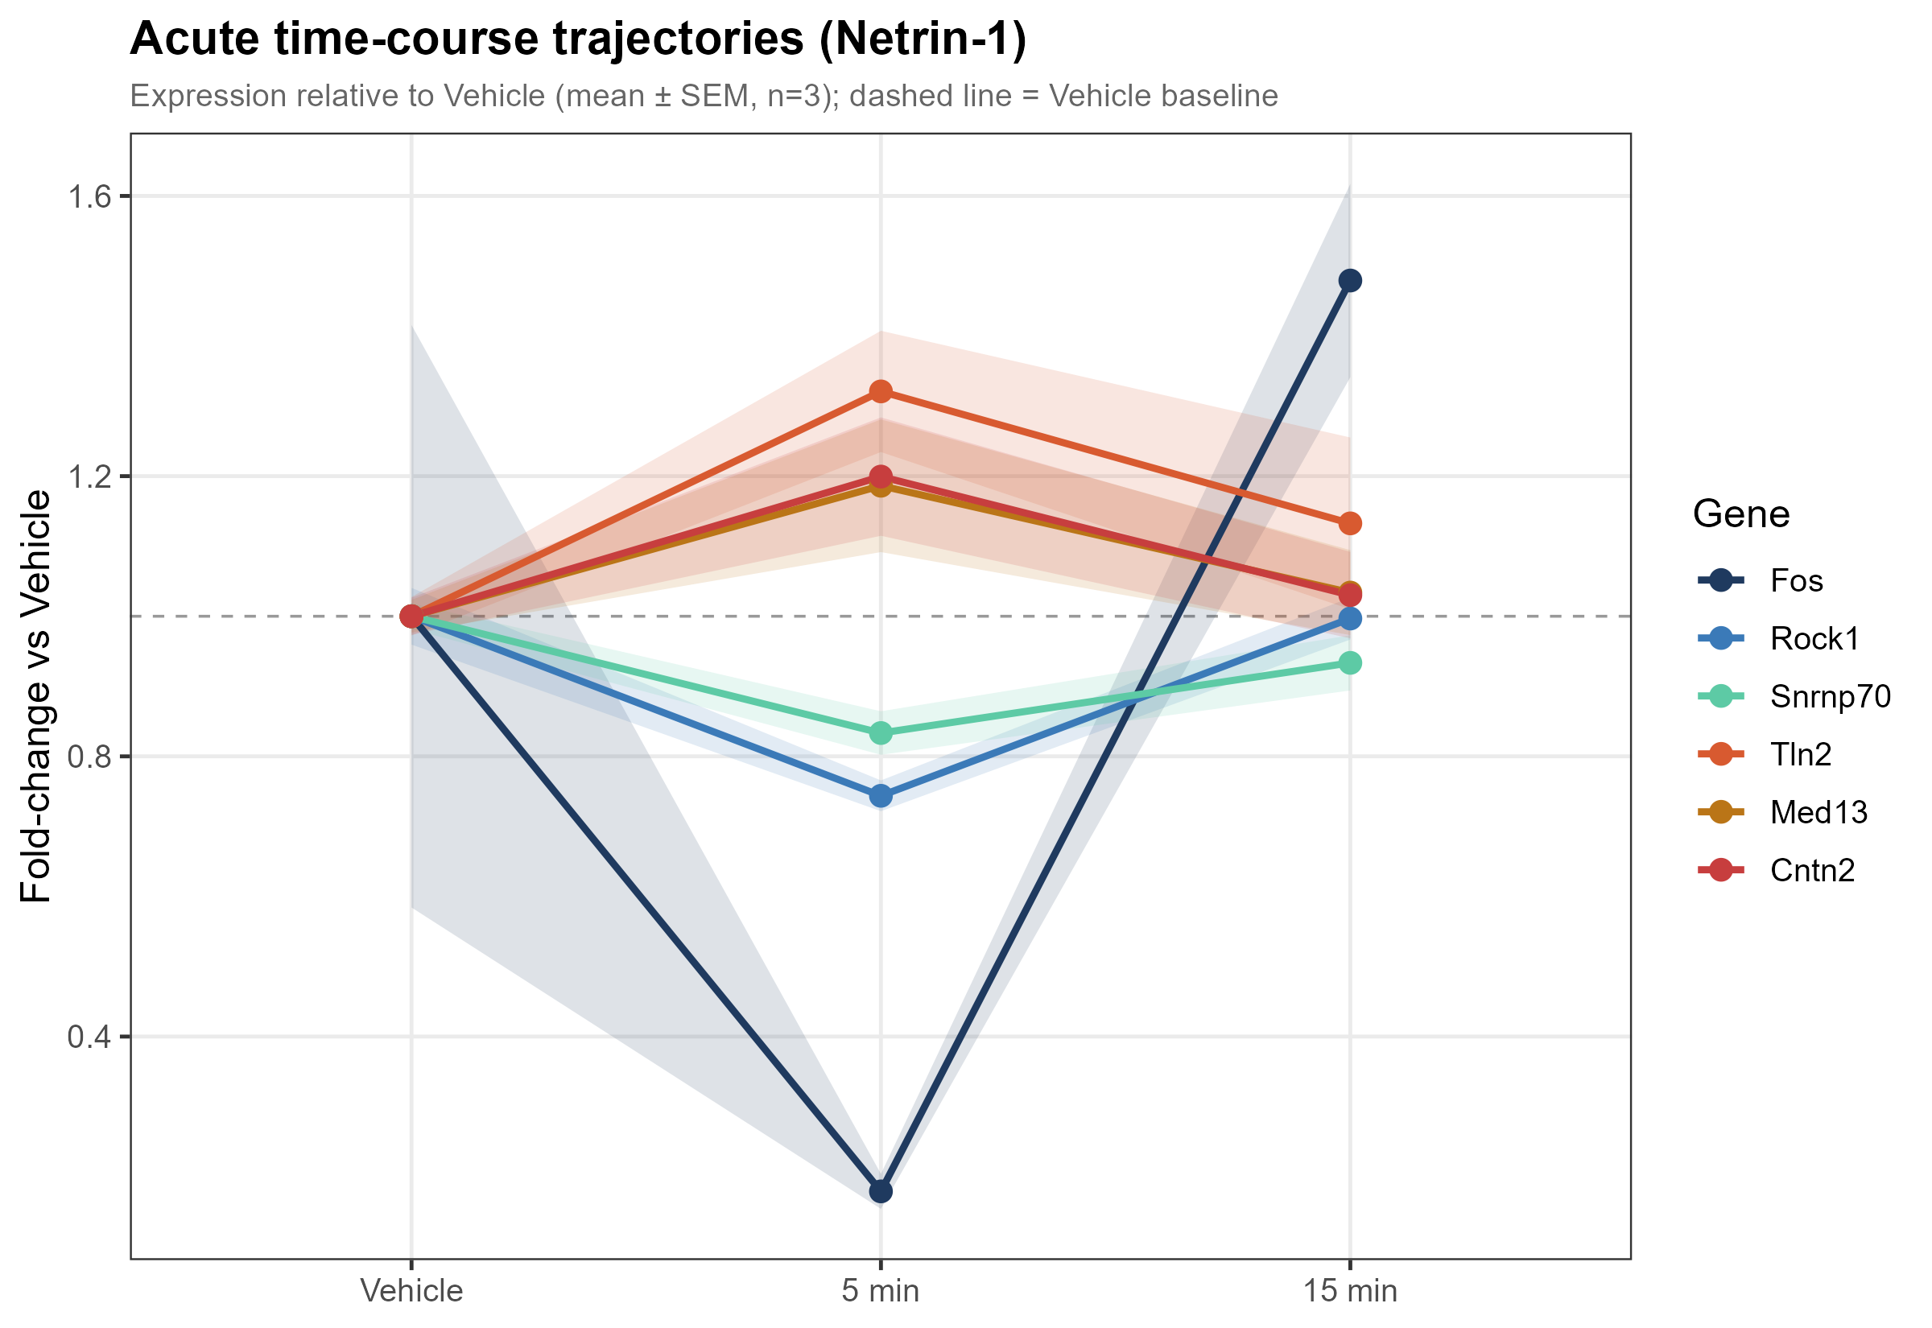
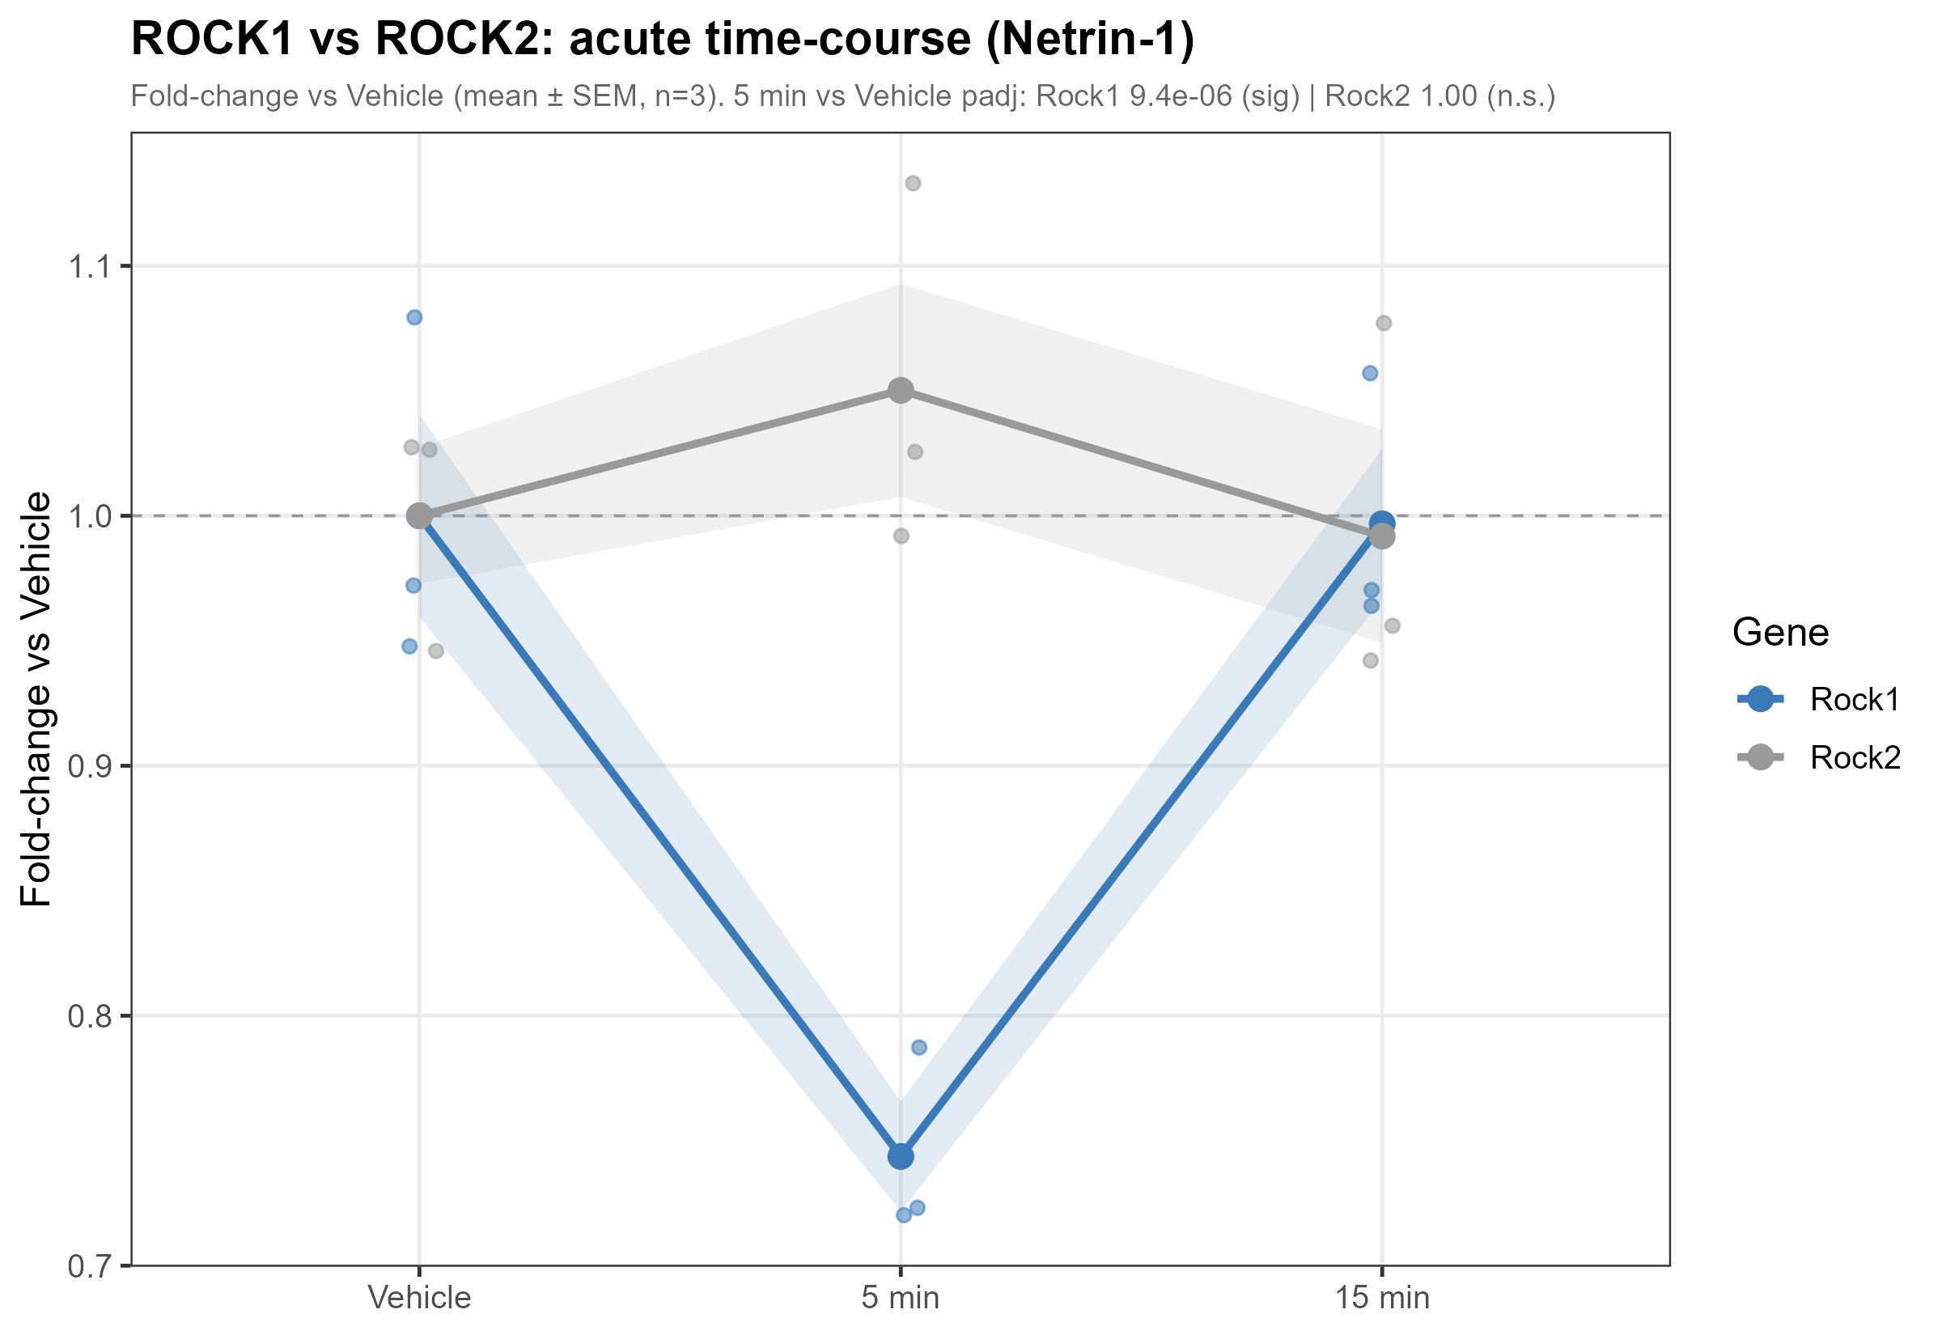
GENE-LEVEL DYNAMICS
Representative trajectories show pulse-like behavior and ROCK1 specificity
Rock1 is down at 5 min; Rock2 remains statistically unchanged.
Source: results/03_DEG trajectory figures
12
Notes:
This combines two handmade result slides in a more compact visual comparison.

Slide 13
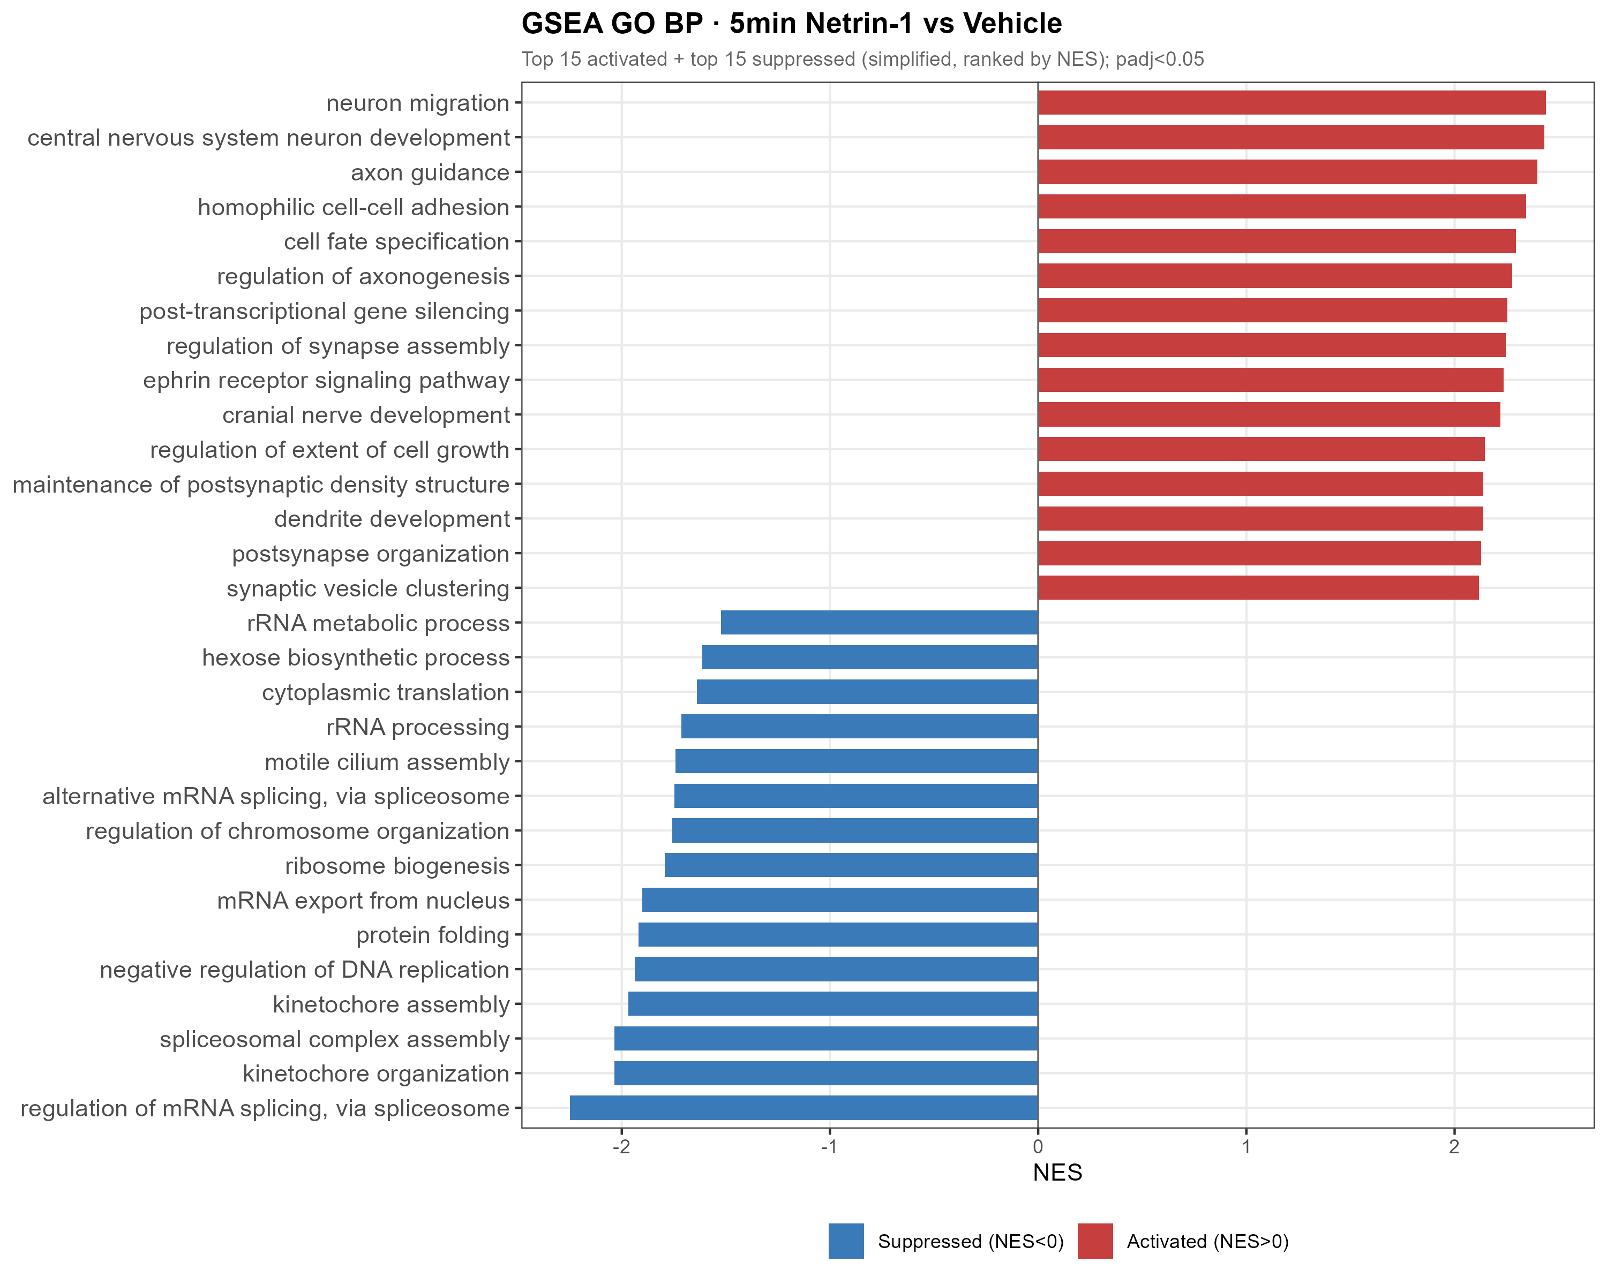
5-MIN GSEA: GO BP
Netrin-1 activates neuron projection and axon guidance programs within 5 min
Pathway aggregation reveals a coordinated biological program.
313
significant GO BP terms
285 up
positive NES terms
Source: results/04_GSEA/GSEA_GO_BP_5v0.csv
13
Notes:
This is the central pathway slide.

Slide 14
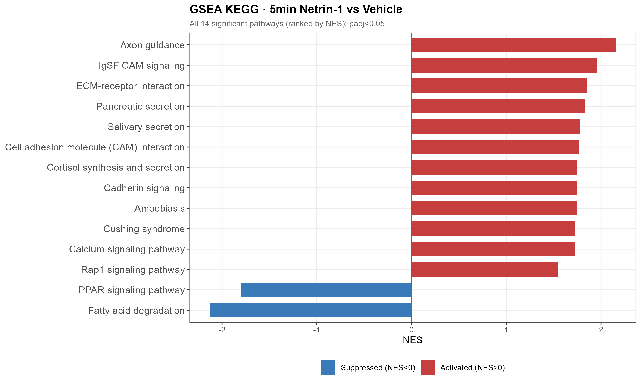
5-MIN GSEA: KEGG
Axon guidance is the top KEGG pathway in the acute response
This connects the RNA-seq response to Netrin-1's canonical biology.
Top pathway
Axon guidance
NES 2.16
BH-adjusted p = 4.1e-7
Source: results/04_GSEA/GSEA_KEGG_5v0.csv
14
Notes:
Different layout from GO BP: text anchor on left, figure on right.

Slide 15
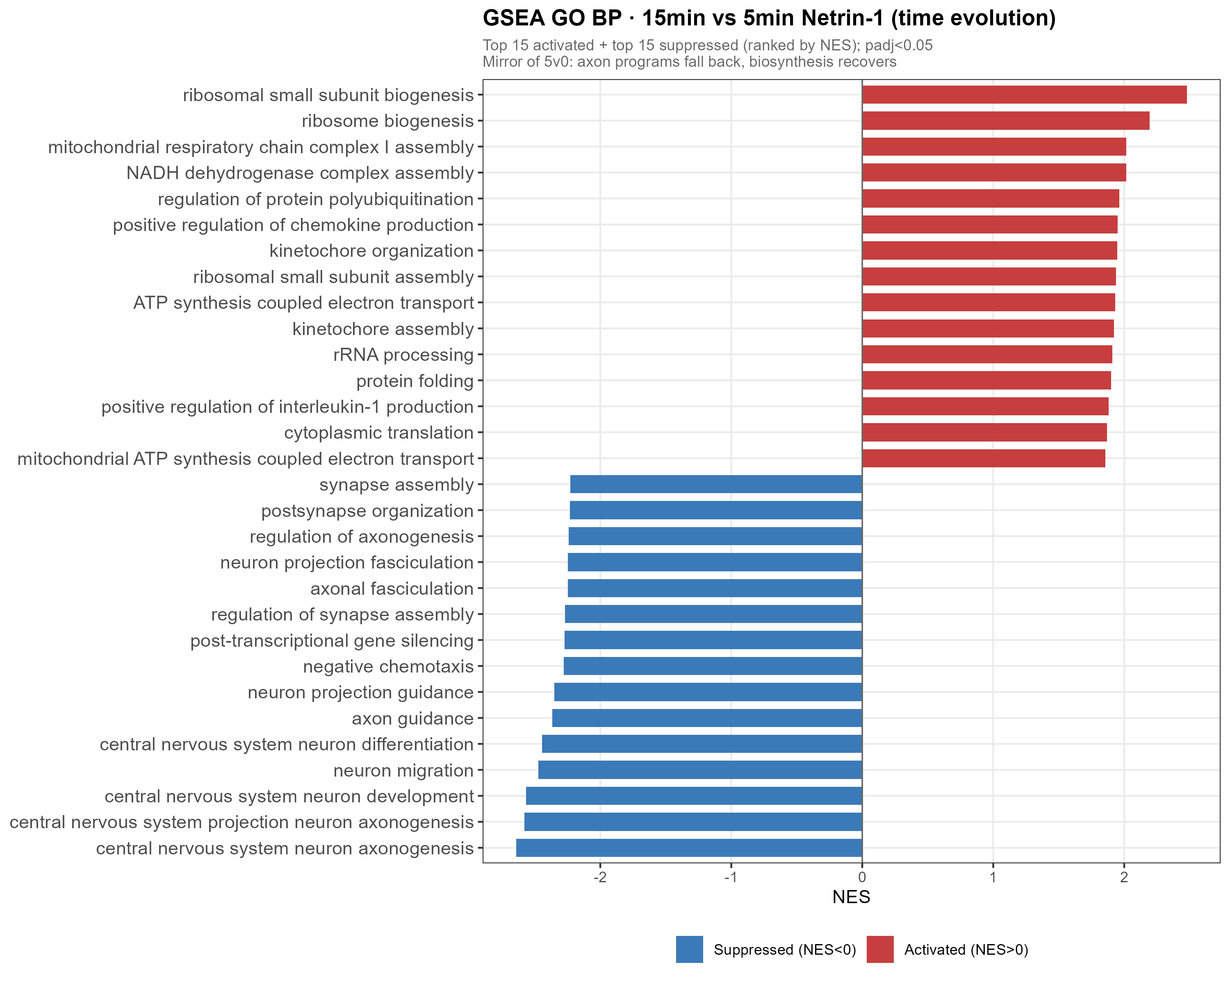
15v5 REVERSAL
By 15 min, the 5-min GO BP program is directionally flipped
295
significant terms
264
negative NES terms
Source: results/04_GSEA/GSEA_GO_BP_15v5.csv
15
Notes:
This mirrors the GO BP slide but uses a softer background to mark the second half of the story.

Slide 16
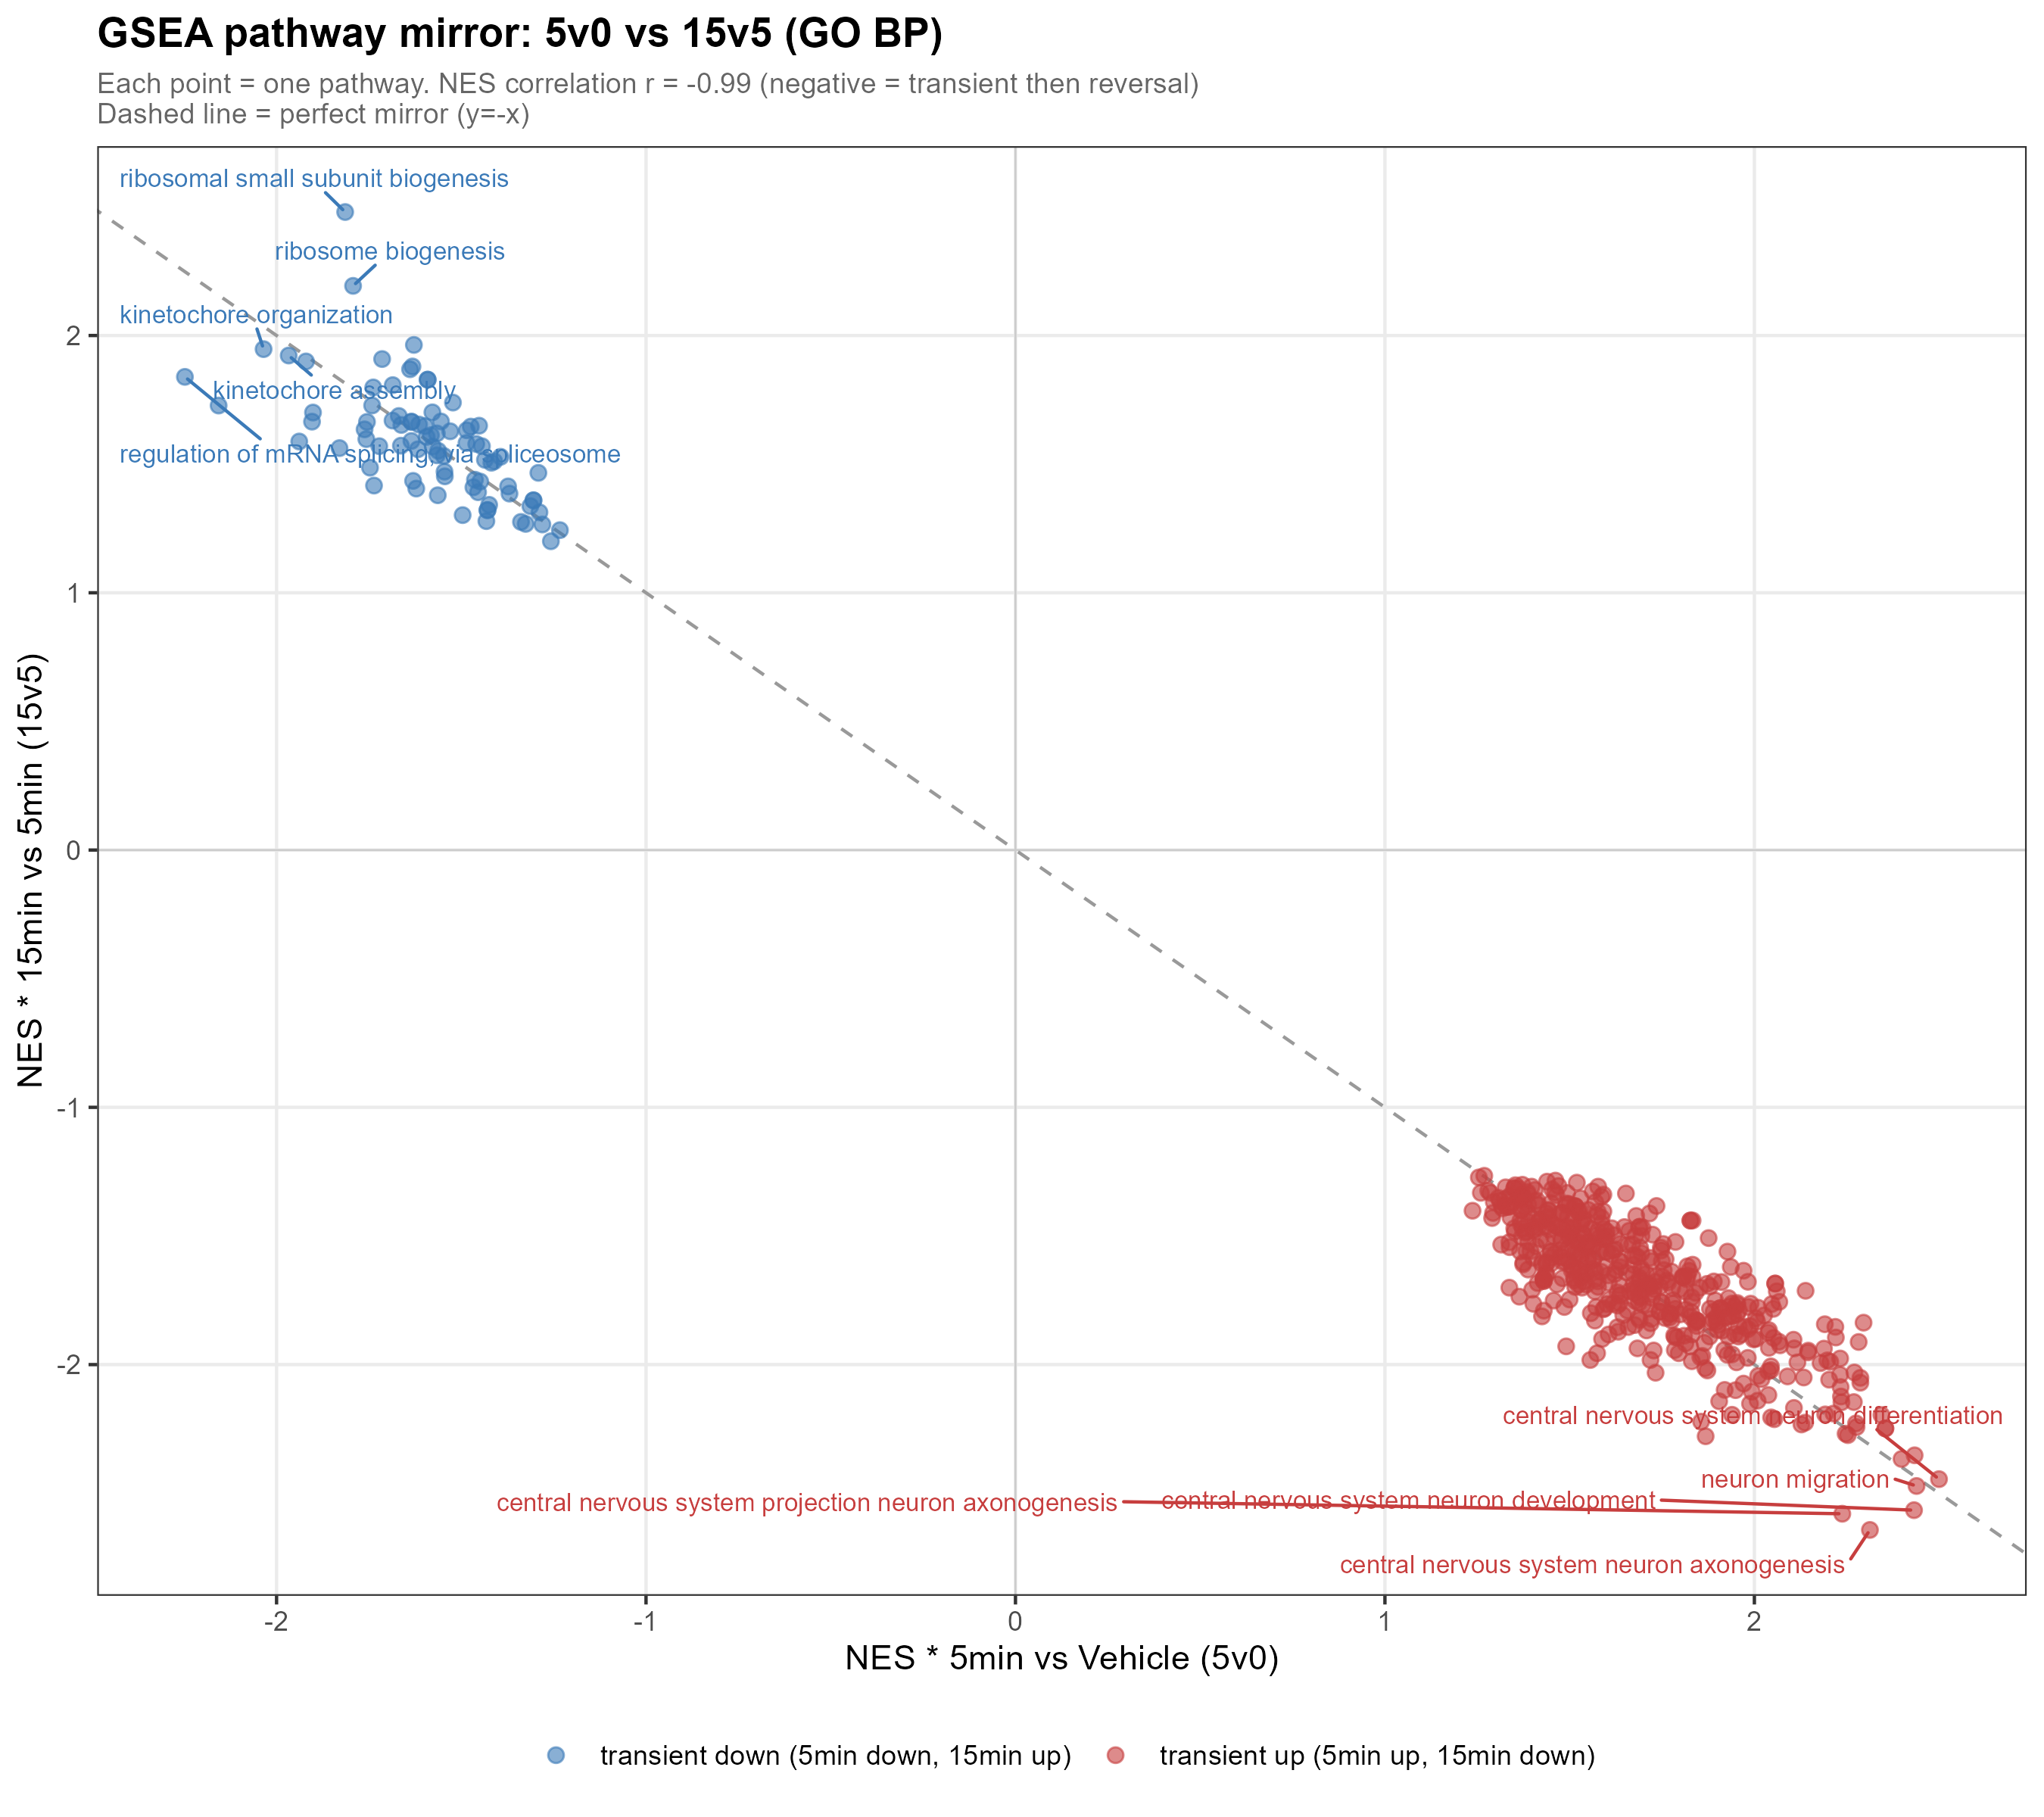
PATHWAY MIRROR
Shared pathways show near-perfect reversal between 5v0 and 15v5
603
shared pathways
NES correlation
r = -0.991
Source: results/04_GSEA/13_GSEA_mirror_scatter_5v0_vs_15v5.png
16
Notes:
This is intentionally a dark accent slide so the strongest result feels visually distinct.

Slide 17
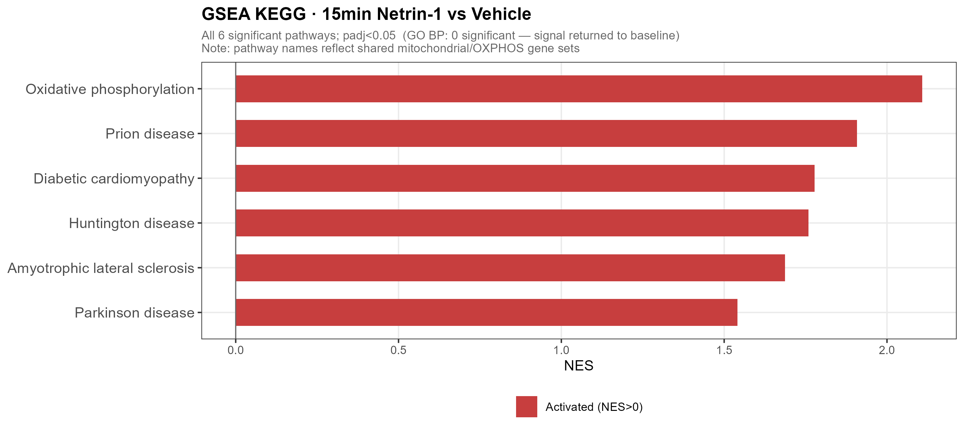
15V0 ENDPOINT
15v0 supports return toward baseline, with a mild mitochondrial KEGG signal
This slide keeps the conclusion scientifically careful.
Caveat
- GO BP: 0 significant terms
- DEG: 1 significant gene
- KEGG: OXPHOS/mitochondrial signal
- Disease labels reflect shared mitochondrial genes
Source: GSEA_GO_BP_15v0.csv and GSEA_KEGG_15v0.csv
17
Notes:
Keep this caveat; it makes the result more defensible.

Slide 18
INTEGRATED RESULT
A brief Netrin-1 stimulus produces a reversible transcriptional program
The result is strongest when DEG, LRT and GSEA are read as one chain of evidence.
1
Acute cue
2
5-min pulse
3
15-min reversal
>
>
Netrin-1 stimulation
guidance/projection up
RNA processing down
pathway mirror r = -0.991
Take-home: the 5-min response is modest at the DEG level but strongly coordinated at the pathway level, and it is rapidly reversed by 15 min.
Integrated from handmade content and local result files
18
Notes:
End with the model and one take-home sentence.

